Slide 1
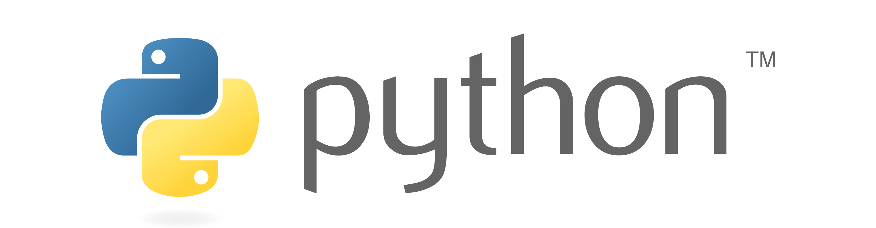
Introduction to PYTHON

Slide 2
Computer
A computer is an electronic device which performs arithmetical and logical operations but computer can not solve problem it self, it must be programmed by user.
Program
A program is a set of instructions or statements written in computer understandable languages.
There are 3 types of computer languages:
Machine language
Assembly language
High level language

Slide 3
Translators
Translator is a program who convert the source language to target language.
There are three types of Translator in C.
Assembler
Compiler
Interpreter

Slide 4
What Is Python?
01
Python is a general-purpose interpreted, interactive, object-oriented, and high-level programming language.
02
It uses English keywords frequently whereas the other languages use punctuations. It has fewer syntactical constructions than other languages.
03
Python supports Object-Oriented style or technique of programming that encapsulates code within objects.
04
Python was made available to public in 1991. The official Date of Python is Feb 20th 1991.
05
Python source code is also available under the GNU General Public License (GPL)

Slide 5

History Of Python
Python was developed by Guido van Rossum in 1990 at the research institute Centrum Wiskunde & Informatica (CWI) in Amsterdam, Netherlands.
Gudio Van Rossum

Slide 6
More about Python
Python is derived from many other languages, including ABC, Modula-3, C, C++, Algol-68, SmallTalk, and Unix shell and other scripting languages.
Python is copyrighted. Like Perl, Python source code is now available under the GNU General Public License (GPL).
Python is now maintained by a core development team at the institute, although Guido van Rossum still holds a vital role in directing its progress.
Python 1.0 was released in November 1994. In 2000, Python 2.0 was released. Python 2.7.11 is the latest edition of Python 2.
Meanwhile, Python 3.0 was released in 2008. Python 3 is not backward compatible with Python 2.

Slide 7
Python Features
Easy-to-learn: Python has few keywords, simple structure, and a clearly defined syntax. This allows a student to pick up the language quickly.
Easy-to-read: Python code is more clearly defined and visible to the eyes.
Easy-to-maintain: Python's source code is fairly easy-to-maintain.
A broad standard library: Python's bulk of the library is very portable and cross platform compatible on UNIX, Windows, and Macintosh.
Interactive Mode: Python has support for an interactive mode, which allows

Slide 8
Portable: Python can run on a wide variety of hardware platforms and has the same interface on all platforms.
Extendable: You can add low-level modules to the Python interpreter. These modules enable programmers to add to or customize their tools to be more efficient.
Databases: Python provides interfaces to all major commercial databases.
GUI Programming: Python supports GUI applications that can be created and ported to many system calls, libraries and windows systems, such as Windows MFC, Macintosh, and the X Window system of Unix.
Scalable: Python provides a better structure and support for large programs than shell scripting.

Slide 9

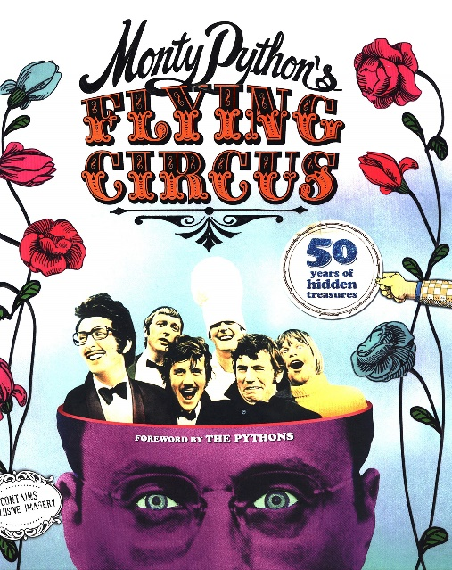
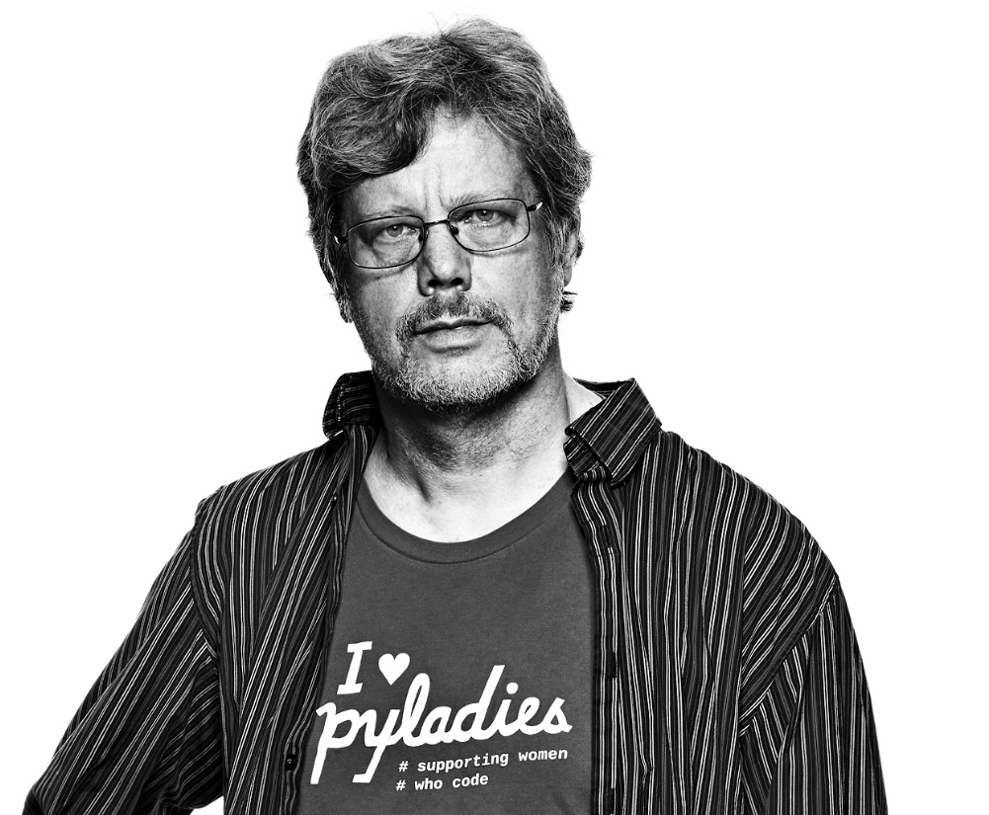
How Python
Got It’s Name?
Python is named after a TV Show called ‘Monty Python’s Flying Circus’ and not after Python-the snake.

Slide 10
Python Version Release Year
Python 1.0 - Jan 1994
Python 1.5 - 31 Dec 1997
Python 1.5.2 - April 1999
Python 1.6 - 05 Sep 2000
Python 2.0 - 16 Oct 2000
Python 2.0.1 - 22 Jun 2001
Python 2.1 - 17 April 2001
Python 2.2 - 21 Dec 2001
Python 2.3 - 29 Jul 2003
Python 2.4 - 30 Nov 2004
Python 2.5 - 19 Sep 2006
Python 2.6 - 01 Oct 2008
Python 2.7 - 03 Jul 2010
Python3 Version Release Year
Python 3.1 - 27 Jun 2009
Python 3.2 - 20 Feb 2011
Python 3.3 - 29 Sep 2012
Python 3.4 - 6 Mar 2014
Python 3.5 - 13 Sep 2015
Python 3.6 - 23 Dec 2016
Python 3.7 - 27 Jun 2018
Python 3.8 - 14 Oct 2019
Python 3.9 - 05 Oct 2020
MACHINE LEARNING
**Note -

Slide 11
Python Application
Image Processing Application
Web Development
Django and Pyramid framework(Use for heavy applications)
Flask and Bottle (Micro-framework)
Plone and Django CMS (Advance Content management)
OpenCV
Pillow
SimpleITK
Enterprise Application
Desktop GUI Application
Tkinter or Tk
wxWidgetM
Kivy (used for writing multitouch applications )
PyQt or Pyside
OpenERP
Tryton
Picalo
Python
Application
Audio or Video Application
3D CAD Application
Fandango (Popular )
CAMVOX
HeeksCNC
AnyCAD
RCAM
Scientific & Numeric
Gstreamer
Pyglet
QT Phonon
SciPy
Scikit-learn
NumPy
Pandas
Matplotlib

Slide 12
Python Compilers
A Python Compiler converts the program source code into byte code.
Type of Python Compilers :-
CPython
Jpython/ Jython
PyPy
RubyPython
IronPython
StacklessPython
Pythonxy
AnacondaPython

Slide 13
How Python Works?
Write Source Code / Program
Compile the Program using Python Compiler
Compiler Converts the Python Program into byte Code
Computer/Machine Can not understand Byte Code so we convert it into Machine Code using PVM
PVM uses an interpreter which understands the byte code and convert it into machine code
Machine Code instructions are then executed by the processor and results are displayed
Write Source Code / Program
Compile the Program using Python Compiler
Compiler Converts the Python Program into byte Code
Computer/Machine Can not understand Byte Code so we convert it into Machine Code using PVM
PVM uses an interpreter which understands the byte code and convert it into machine code
Machine Code instructions are then executed by the processor and results are displayed
Source Code/ Program
Run Program
using PVM
Source Code/ Program
Source Code/ Program
Byte Code
Byte Code
Binary Code / Machine Code
Computer
Compile using
Python Compiler
Output
hep4code.py
help4code.pyc

Slide 14
Python Virtual Machine
Python Virtual Machine (PVM) is a program which provides programming environment. The role of PVM is to convert the byte code instructions into machine code so the computer can execute those machine code instructions and display the output.
Interpreter converts the byte code into machine code and sends that machine code to the computer processor for execution.
Source Code/ Program
Byte Code
Interpreter
Binary Code / Machine Code
Computer
Compile using
Python Compiler
Output
help4code.py
help4code.pyc
PVM

Slide 15

Download & Install Python
Python Learning
Installation on Windows
Visit Link :
https://www.python.org/downloads/
to download the latest release of Python
Download & Install VS CODE
Installation on Windows
Visit Link :
https://code.visualstudio.com/downloadto download the latest release of VS CODE

